Slide 1
Emergent Behavior in Quantum Matter
David Pines, Santa Fe Institute, UC Davis, and UIUC
In quantum matter, the interactions between electrons, ions and their environment give rise to unpredicted emergent collective behavior at every scale. In this, my Lilienfeld Prize lecture, I will review the steps I took to identify the origins of the emergent behavior noted in my prize citation:
*collective modes in electron and helium liquids
*conventional superconductivity in metals and nuclei
*the celestial superfluidity found in neutron stars
*unconventional superconductivity in cuprates
*the emergence of heavy electrons, antiferromagnetism, and unconventional superconductivity in Kondo lattice materials

Slide 2
In discussing these examples of emergent behavior I am trying to practice what I first preached some 16 years ago.
In our 2000 PNAS manifesto on the future of science, Bob Laughlin and I wrote
“The central task of theoretical physics in our time is no longer to write down the ultimate equations but rather to catalogue and understand [i.e., collect and organize] emergent behavior in its many guises, including life itself”

Slide 3
1950 Plasmons emerge. In my PhD. thesis and a series of papers written with my adviser, David Bohm, we showed that the Coulomb interaction between valence electrons would give rise to a new collective mode- quantized plasma oscillations. We
focused on the collective behavior of their density fluctuations
showed that in the random phase approximation [RPA] the long range of their Coulomb interaction led to collective plasma oscillations whose energy at long wavelengths, ħω_{p} =[4πne²/m] ^{½}, was so high that only interband transitions could damp them.
Conyers Herring then told us that these had likely been seen in experiments by Ruthemann and Lang on the inelastic scattering of electrons by thin metallic samples in 1948-50. They found quantized high energy losses for Be [19eV] and Al [16eV] that were close to their valence electron plasma oscillation energies, 19eV and 15eV.

Slide 4
In the discussion after my 1954 Solvay lecture on the collective description of electron interactions, Neville Mott gave a simple sum rule argument that suggested that for most solids interband transitions would play a negligible role in shifting and damping the valence electron plasma wave.
By the the spring of 1955 the experimental evidence for quantized plasma oscillations, plasmons, had become quite strong. Inelastic electron scattering experiments [EELS] had found quantized energy losses that were quite close to the valence electron plasmon energy for some 23 metals, insulators, and semiconductors.
I could then comfortably argue that plasmons had now joined phonons and quasi-electrons as fundamental elementary excitations in solids, although John Slater did not agree.

Slide 5
From Plasmons to Plasmonics
Because the surface plasmons [waves of charge bound to the surface]then proposed by Ritchie can now be controlled in a number of ways, plasmons have turned out to be of very considerable practical importance in the development of new nanoelectronic devices.
Their study was named Plasmonics [ cf Atwater, The Promise of Plasmonics, 2005 Scientific American] and is now a major sub-field of nanoelectronics with Gordon Conferences and a Springer Journal devoted to the topic.
In introducing a 2015 Faraday Discussion on “Nanoplasmonics”, Brongersma remarked that the number of publications on plasmonics has been doubling about every three years since 1990, with some 10,000 publications on the topic now appearing annually

Slide 6


Plasmons are only example of collisionless collective modes that originate in the bare particle interaction.
The collisionless collective modes seen in INS experiments on the density fluctuation spectrum of liquid ³He [zero sound] and both normal and superfluid ⁴He [the phonon-maxon-roton spectrum] originate in a modified effective particle interaction
Aldrich, Pethick, and Pines [APP] established their common origin by addressing the inverse problem—using experiments on ⁴He to deduce restoring forces-polarization potentials- for both liquids that are quite similar, with differences introduced by isotopic mass, pressure, and quantum statistics:
a scalar field
and a vector backflow field

Slide 7
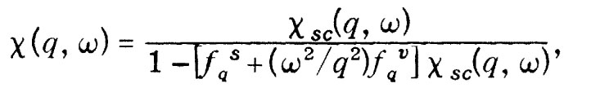
In this phenomenological extension of Landau’s Fermi liquid theory and Feynman’s backflow, the density-density response function measured in INS experiments is then given by
where Χ_{sc} is given by the non-interacting response functions for
the liquid in question.
APP argued that the dominant physical effect of the liquid on the bare He atom interaction would be to modify its short-range behavior. We described this by introducing a pseudopotential, f^{s}[r] = a[1-r/r_{c}]⁸ r<r_{c ,} that is joined to the unchanged attractive long range part by a simple fitting function.

Slide 8
⁴He: since f₀^{s}, the spatial average of f[r], is known from the compressibility, for a given choice of range, r_{c}, the strength, a, of the soft core repulsion is uniquely determined, while r_{c} is determined by the pressure-dependent zero point motion of the atoms in the liquid.
³He: the range of the repulsion will increase because of its increased zero point motion, while the Pauli principle will lead to a further increase in range for particles of parallel spin; one can then use the spin susceptibility and the compressibility to fix the strength of the different interactions between particles of parallel and antiparallel spin.
On assuming the backflow potential has a range ~ that for the scalar potential, APP obtained quite good fits to the pressure dependence of the collective modes seen in both ⁴He and ³He.

Slide 9
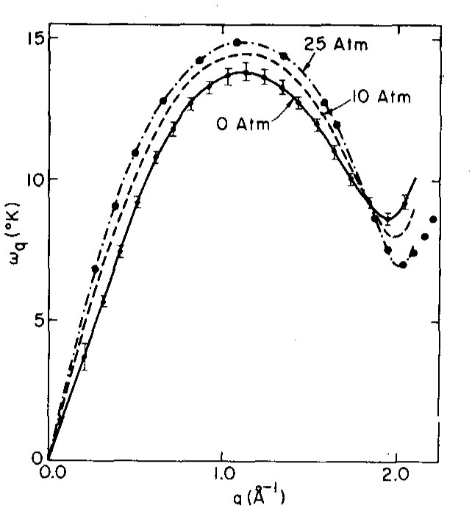
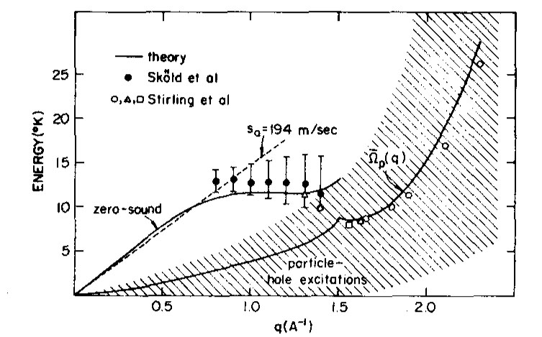
Theory vs experiment for ⁴He and ³He

Slide 10
Superconductivity: the poster child for emergent behavior in matter
Cool most non-magnetic metals down far enough-that is to temperatures < 25K- and a new property emerges – they become superconductors, metals that are perfect diamagnets and conductors, and levitate in a magnetic field.
Following its discovery by Kamerlingh-Onnes in 1911, understanding superconductivity became one of the major problems in all of physics

Slide 11
.
From 1920 on every giant in theoretical physics from Einstein, Bohr, and Heisenberg to Lee and Yang and Feynman tried without success to answer two fundamental questions:
What is the mechanism responsible for superconductivity and what is the emergent order that characterizes it?
Over forty years were to elapse between its discovery and the 1955-56 identification of the mechanism, an identification that was soon followed by the successful microscopic theory of Bardeen, Cooper, and Schrieffer in 1957.

Slide 12
Why did it take so long?
~20 years for the development of a description of matter at the quantum level--
~20 years in which we were clueless-no experiments provided the smoking gun for the mechanism
The 1950 experimental breakthrough was the discovery at Rutgers and NBS that in Pb the superconducting transition temperature, T_{c}, varies as [M]^{-1/2} where M is the isotopic mass
This made it clear that phonons-the quantized vibrations of the periodic lattice of ions- must play a key role in bringing about superconductivity
But since superconductivity is an electronic phenomenon, phonons could only be important insofar as they affected the behavior of electrons

Slide 13
1950-51: Frohlich and Bardeen developed theories in which phonons changed the self-energy of electrons, but their papers only extended the list of failed efforts to explain superconductivity
1952: Frohlich then used second-order perturbation theory to calculate the phonon-induced interaction between electrons and found it gave rise to an attractive interaction
He suggested this could be the origin of superconductivity
However, he had ignored the expected much larger repulsive interaction; as Landau put it, “You can’t repeal Coulomb’s law.”

Slide 14
1954: In an Urbana collaboration with John Bardeen I was able to resolve that issue by extending the Bohm-Pines “Collective Description of Electron Interactions” to include ionic motion within the RPA.
We found that, contrary to the general expectation, at low frequencies the screened phonon-induced interaction could win out over the screened repulsive Coulomb interaction, so that the overall effective interaction would be attractive
We concluded our 1955 paper by stating that our effective frequency-dependent interaction would be a good starting point for developing a microscopic theory of superconductivity

Slide 15
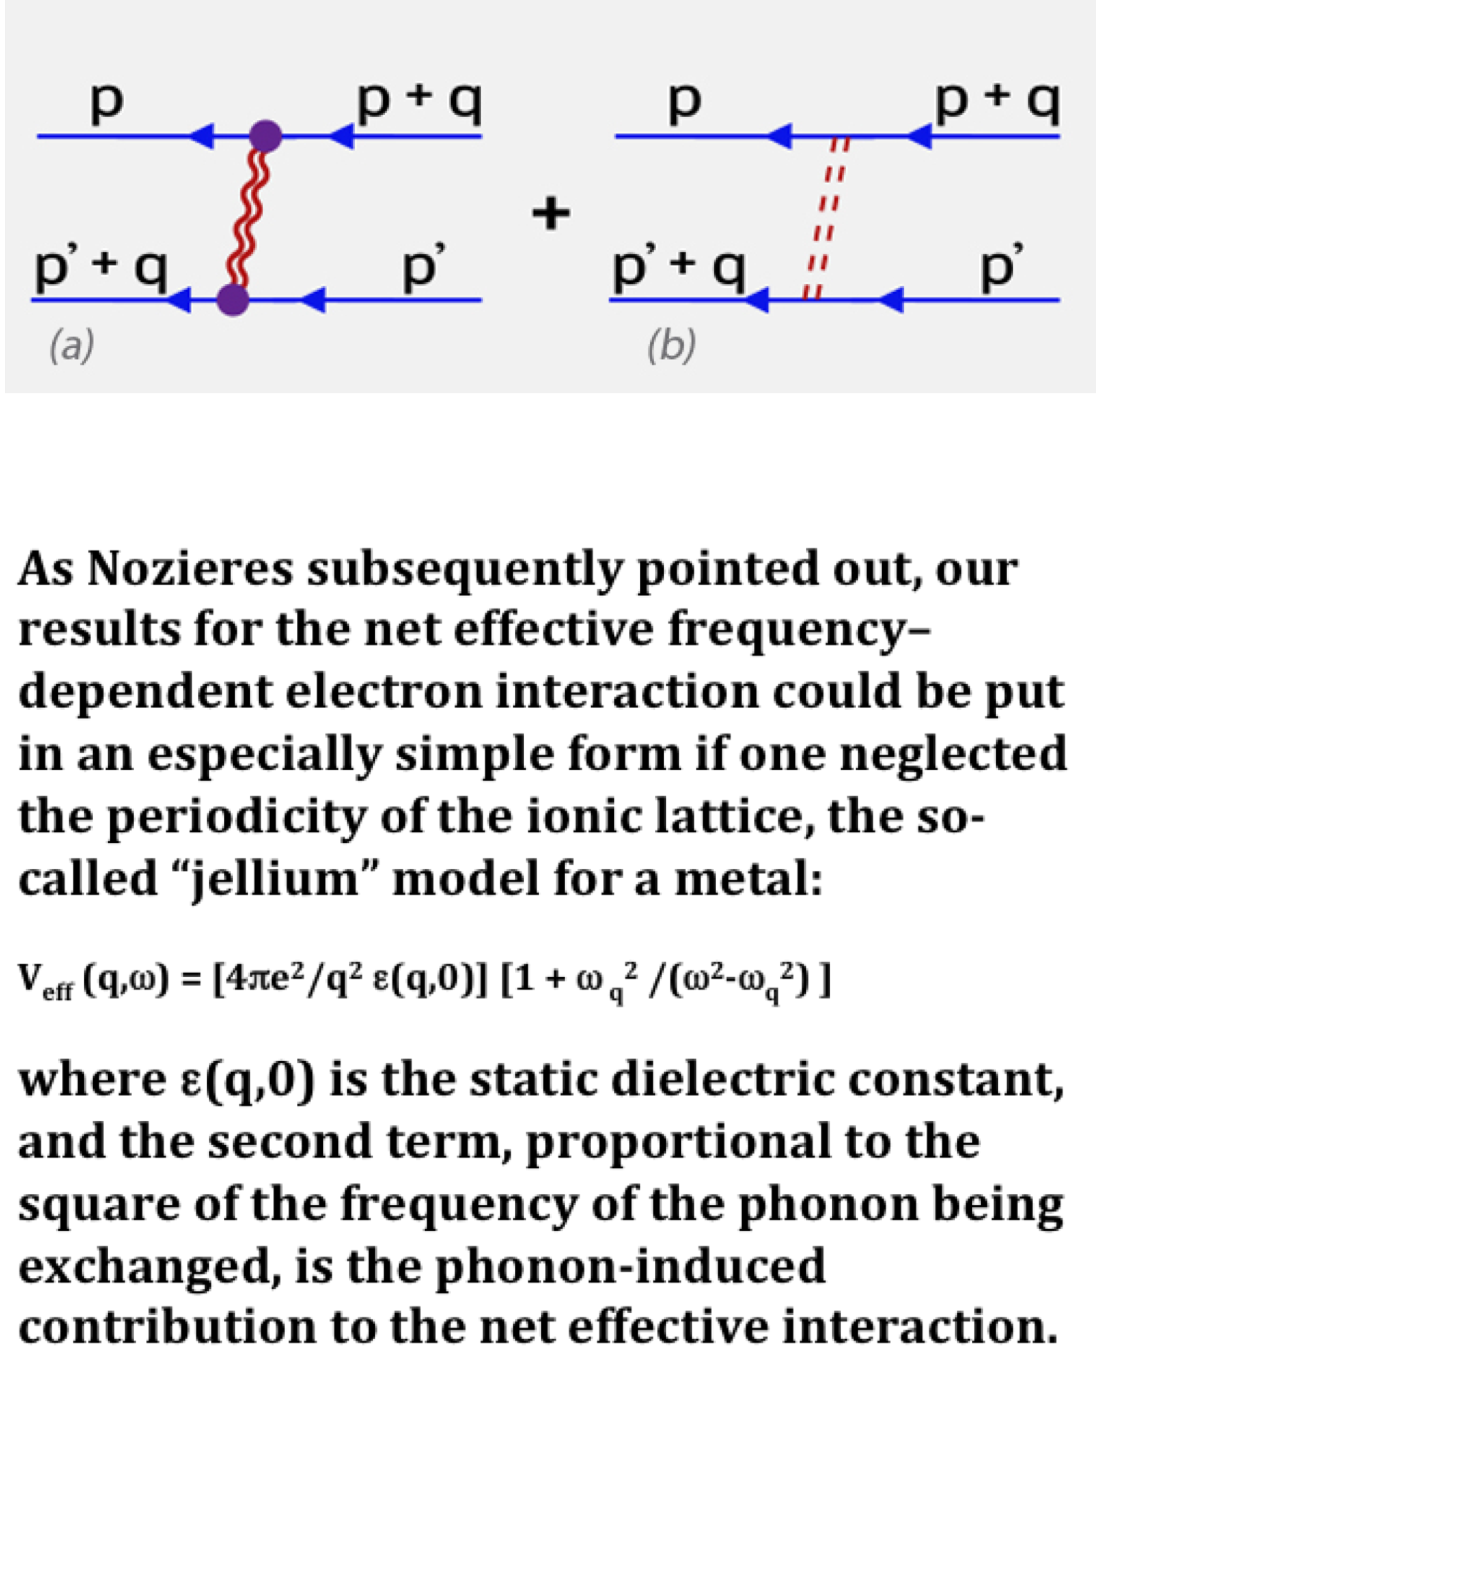

Slide 16
1956: Leon Cooper used a toy model of the Bardeen-Pines-Frohlich attraction in which pairs of electrons lying within a Debye energy of the Fermi surface felt a constant attraction, with no interaction otherwise, to show that an energy gap would develop. Cooper neglected hole-hole scattering; when it is included, one finds normal metals become unstable against pair formation
1957 January: Bob Schrieffer proposed a very appealing candidate wave function for the sc state in which the emergent superfluid order was the macroscopic occupation of a single quantum state, into which electron pairs of opposite spin had condensed; it cost a finite energy to excite a single electron from the condensate. He was immediately joined in developing a microscopic theory by Bardeen and Cooper.
1957 Between February and June, BCS emerged; it explained all existing experiments and a dramatic difference between NMR spin-lattice relaxation and ultrasonic attenuation experiments.

Slide 17
1957 April: Explaining the Matthias Rules
During lectures to my class in Princeton on the just
published BCS PRL summarizing their theory, I used a simplification of the BP effective interaction to show that the added attraction from Umklapprocesses explained the famous Matthias rules for the appearance of superconductivity in the periodic system
1957 Summer: Nuclear Superfluids
I remarked, during a June lecture on BCS at the Bohr Institute, that because the basic hadron interaction is attractive, one might expect nuclei to exhibit superfluid behavior. Aage Bohr, Ben Mottelson joined me over the summer in studying this first extension of BCS to other fermions. We found that nuclear superfluidity could explain a number of puzzling pairing phenomena in nuclei.

Slide 18
Celestial Superfluids
*1963 Arkady Midgal suggested that since BMP had shown that hadron attraction led to pairing phenomena in the outer shells of nuclei, the neutron stars first studied by Robert Oppenheimer would exhibit superfluid behavior
*1965 Vitaly Ginsberg and David Kirshnitz noted that since all stars rotate, the rotation of such superfluid neutron stars should be described in terms of the quantized vortex lines that had been seen in superfluid ⁴He.
*1967-68 Jocelyn Bell discovered pulsars—cosmic sources of pulsed electromagnetic radiation—and while initially called LGM [little green men] these were soon identified as rotating neutron stars with dipolar magnetic fields ~10¹² Gauss.

Slide 19
Our observational knowledge of celestial superfluidity comes from pulsars that glitch. In March, 1969, radio astronomers found that a young and comparatively fast pulsar, the Vela pulsar, which has a ~ 89 ms period of rotation, instead of continuing its remarkably regular spin-down produced by the transformation of its rotational energy into the beams of radio emission observed on Earth, suddenly sped up by a few parts in a million. Then, over some days to weeks, this glitch, the sudden spin-up, decayed.
That such a glitch occurred is remarkable. But even more remarkable is that it could be observed, since the response time for ordinary neutron matter is about 10-⁴ seconds, the time it takes a sound signal to cross the star. So, under normal circumstances, a glitch and its response would be gone in less time than the twinkling of an eye.

Slide 20
A 1969 Aspen Center for Physics collaboration [Baym,Pethick, Pines, Ruderman] argued that the observed post-glitch slow decay provided unambiguous evidence for the presence of superfluid neutrons in the pulsar, since these can only change their angular momentum by the postglitch motion of their vortex lines, a process could easily be imagined to take days to months.
Anderson and Itoh then made a seminal proposal in 1974: glitches must be an intrinsic property of the crustal neutron superfluid that occur because the vortex lines that carry the angular momentum of the crustal superfluid are pinned to the nuclei with which they coexist. As a result, the superfluid's angular velocity, which can change only through the motion of its vortices, will lag that of the crust until a sufficiently large number of vortices are pinned, at which point these unpin catastrophically, bringing about a sudden jump in the angular momentum of the star—a glitch.

Slide 21
*Another Aspen collaboration [Alpar, Anderson, Pines, Shaham] then developed a highly successful phenomenological vortex creep theory of post-glitch behavior.
*Strong, weak, and superweak regions of vortex pinning with distinct inertial moments and glitch response times could produce the linear and non-linear glitch response that has now been identified in the Vela and other pulsars.
Thanks to its continuous monitoring by radioastronomers in Tasmania [Hamilton et al] and South Africa [Clare Flanagan, Sarah Buchner], the Vela pulsar has emerged as the “hydrogen atom” of glitching pulsars.
18 new glitches of the Vela pulsar have been observed since 1969, and their remarkably consistent post-glitch behavior, including the glitch-size related time to the next glitch, is explained by the vortex creep theory developed by Alpar et al..

Slide 22
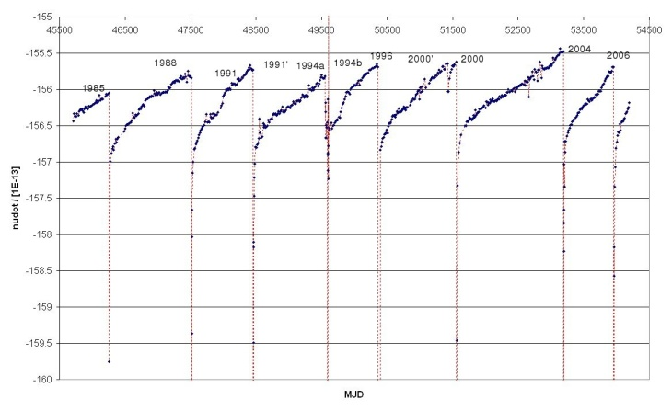
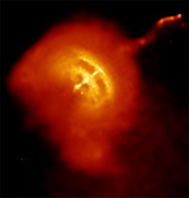
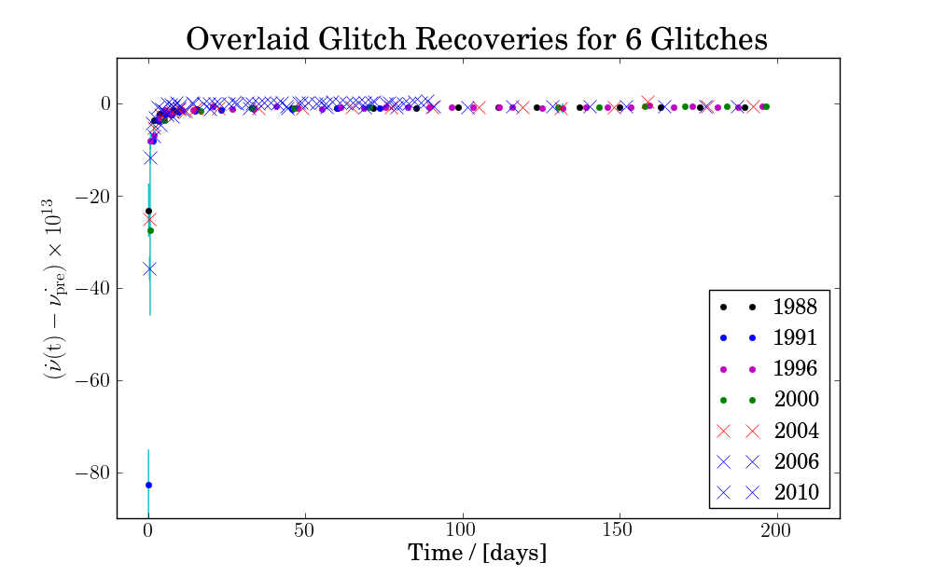
Vela Glitches
Glitch No. | Glitch Date (MJD) | Δν/ν (10⁻⁹) | (10⁻³) | Reference
1 | 40280(4) | 2338(9) | 10.1(3) | Cordes et al. (1988)
2 | 41192(8) | 2047(30) | 14.8(2) | Cordes et al. (1988)
3 | 41312(4) | 12(2) | 1.9(2) | Cordes et al. (1988)
4 | 42683(3) | 1987(8) | 11(1) | Cordes et al. (1988)
5 | 43693(12) | 3063(65) | 18.3(2) | Cordes et al. (1988)
6 | 44888.4(4) | 1138(9) | 8.43(6) | Cordes et al. (1988)
7 | 45192.1(5) | 2051(3) | 23.1(3) | Cordes et al. (1988)
8 | 46259(2) | 1346(5) | 6.16(3) | McCulloch et al. (1987)
9 | 47519.80360(8) | 1805.2(8) | 77(6) | McCulloch et al. (1990)
10 | 48457.4(10) | 2715(2) | 600(60) | Flanagan (1991)
11a | 49559.0(2) | 835(2) | 0(5) | Flanagan (1994)
11b | 49591.82 | 199(2) | 120(20) | Flanagan (1994)
12 | 50369.345(2) | 2110(17) | 5.95(3) | Wang et al. (2000)
13 | 51559.3190(5) | 3085.72(4) | 6.73 | Dodson et al. (2002)
14 | 53193.09 | 2059(6) | 11(2) | Dodson et al. (2004)
15 | 53959.93 | 2620 | 230(40) | Flanagan & Buchner (2006)
16 | 55408 | 1940 | 75(1) | Buchner (2010)
17 | 56555.871 | 3000 | 148(1) | Buchner (2013)
18 | 56922(3) | 0.4 | - | Jankowski et al. (2015)
19 | 57143(3) | 75.6 | - | Palfreyman et al. (2016)

Slide 23
*Based on the roughly 514 glitches in 172 pulsars that have been identified so far, we can easily establish that the amount of cosmic neutron superfluid whose pinning to crustal nuclei has thus far been observed is several solar masses, or some 10³⁴ grams.
That amount of observed and observable superfluid far exceeds the quantity of terrestrial superfluid ever produced or measured, while its calculated maximum superfluid transition temperature of ~10⁶K far exceeds that reached for terrestial superconductors.

Slide 24
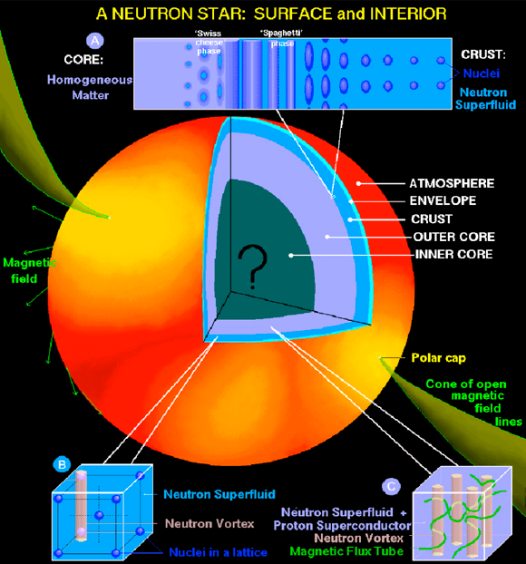

Slide 25
The 1986 discovery of high temperature superconductivity on the border of antiferromagnetism in the hole-doped cuprates, LSCO and YBCO, posed a major new challenge for the condensed matter community.
What was the mechanism and what was the pairing state?
Most of the theoretical community responded to this challenge by attempting to solve a one band version of the Hubbard model or positing a new ground state wavefunction-the resonating valence bond state

Slide 26
Two theoretical groups took a different, experiment-driven approach: a group in Tokyo, led by Akito Moriya and Kazuo Ueda, and our group in Urbana [Philippe Monthoux, Alexander Balatsky, and me].
Both groups explored the possibility that the mechanism was the magnetic analogue of that responsible for conventional superconductivity- an attractive interaction between quasiparticles induced by their coupling to spin fluctuations that originate in a quantum critical point that marks the end of antiferromagnetic behavior.

Slide 27
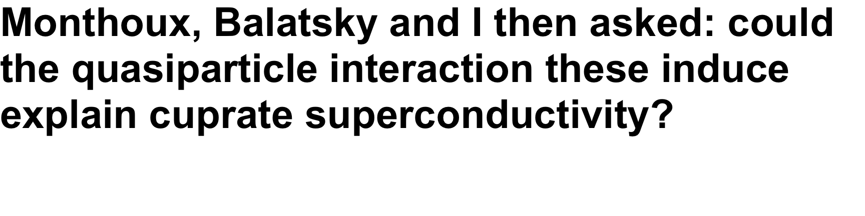
In Urbana we were heavily influenced by the NMR spin-lattice relaxation experiments being carried out down the hall by Charlie Slichter and his group.
Andy Millis, Hartmut, Monien, and I had shown these could be explained by assuming that even optimally doped materials behaved as though they were on the verge of being antiferromagnetic.
The spin-lattice relaxation spin-lattice rate is then determined by quantum critical magnetic fluctuations that took the form

Slide 28
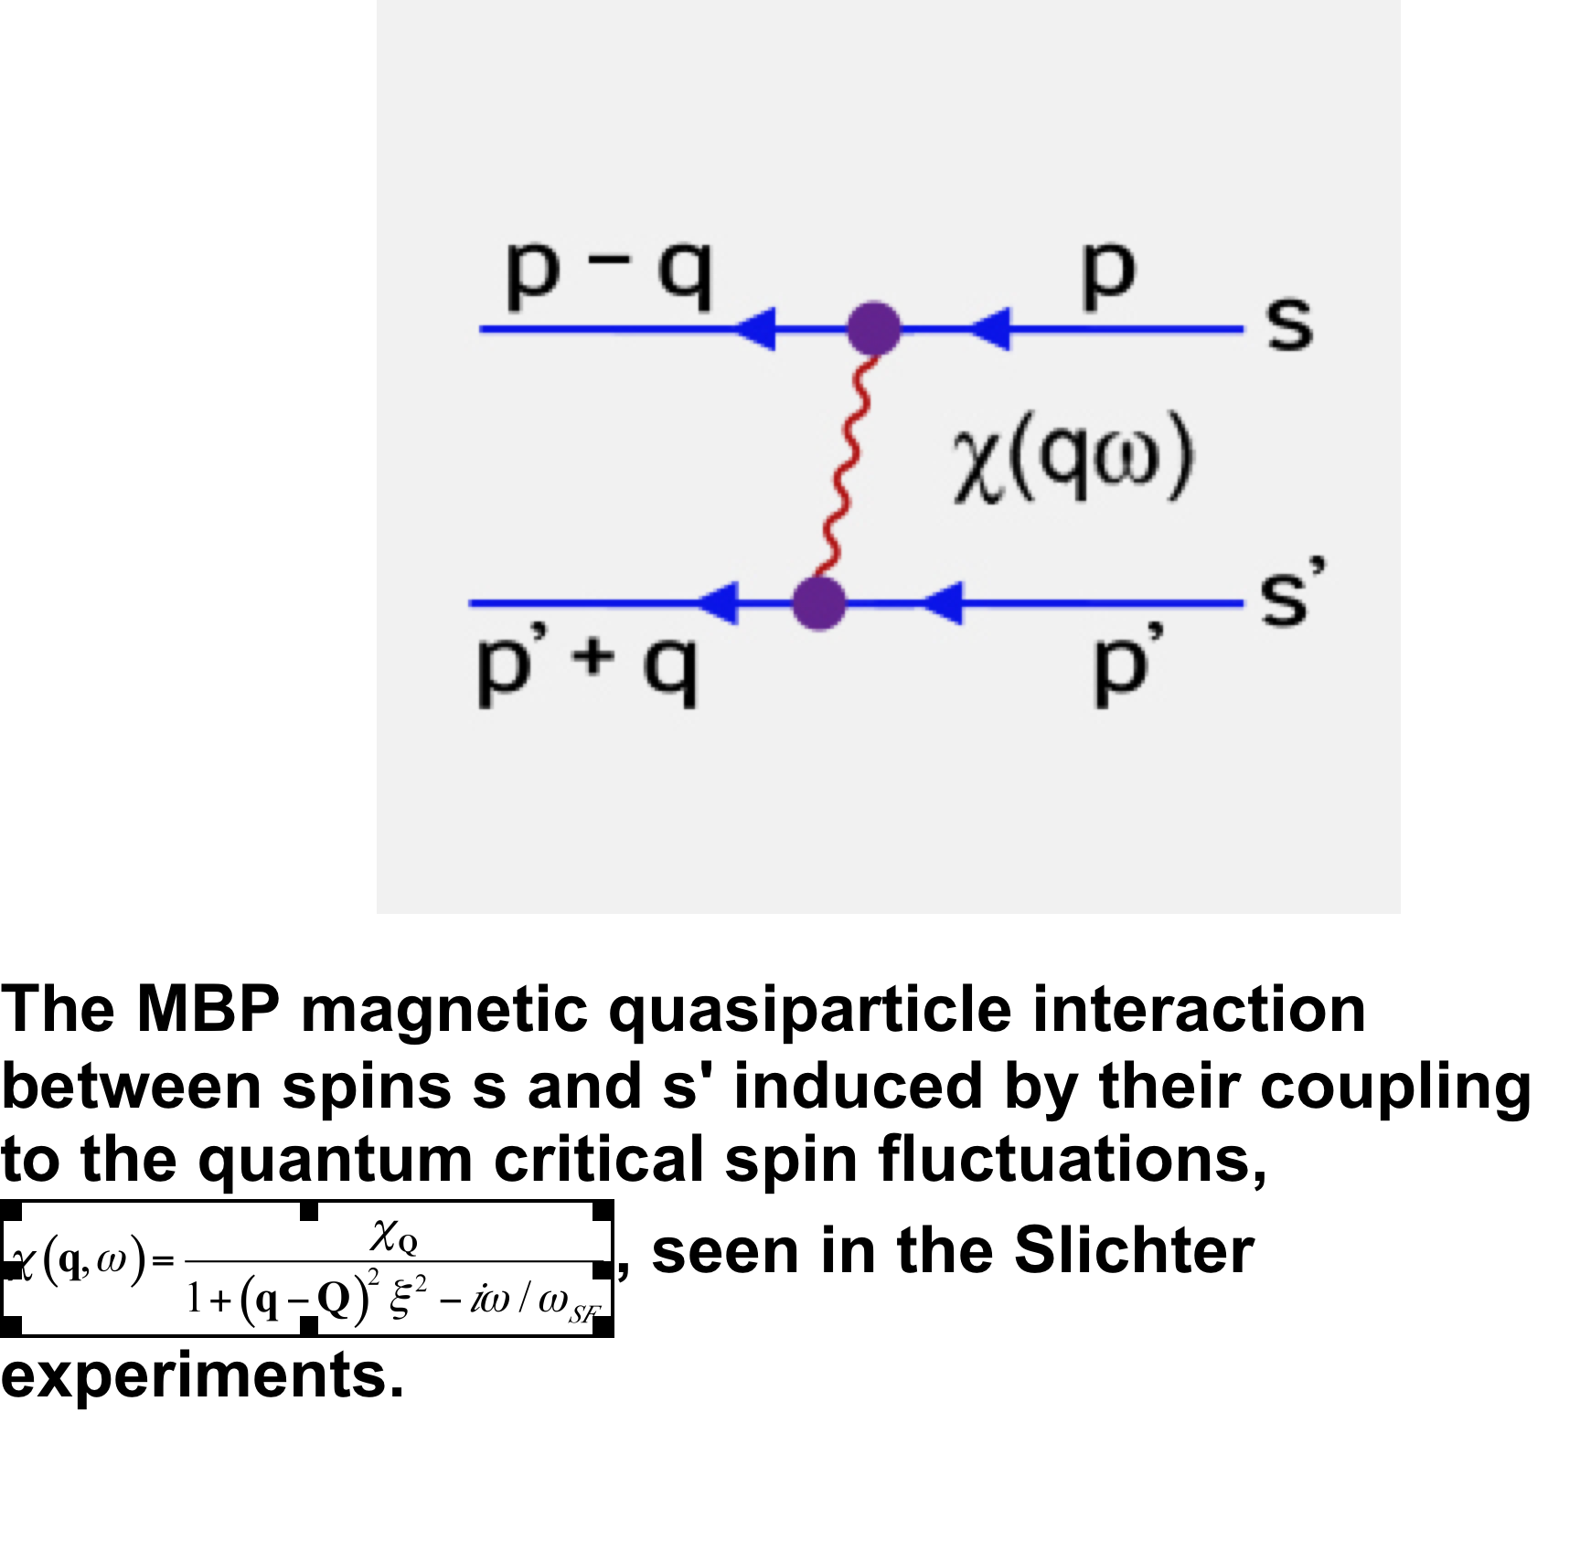

Slide 29
Thanks to Monthoux’s mastery of computational techniques and the proximity of NCSA, we were able to carry out both weak coupling [MBP] and strong coupling calculations [Monthoux and Pines] of the consequences of quasiparticle interactions in which the pairing glue was taken from the MMP fit to the NMR data.
We came to two firm conclusions:
*the pairing state produced by quantum critical spin fluctuation induced quasiparticle interactions would always be d _{x2-y2}
* with realistic parameters, this magnetic interaction could easily yield T_{c}~100K
Taking a somewhat different tack, using Moriya’s theory of QC spin fluctuations, the Tokyo group reached the same conclusion

Slide 30
Over the next two years [92-94] there was a lively debate between adherents of the RVB approach, whose calculations predicted an s wave pairing state, and proponents of the spin-fluctuation mechanism that led to a d-wave pairing state
Our firm prediction of d-wave pairing was verified in Urbana.
First, NMR measurements of the susceptibility and spin-lattice relaxation carried out by the Slichter group gave results consistent with those expected for d-wave pairing.
These were followed by a SQUID experiment suggested by Tony Leggett that measured the pairing symmetry directly.
Using remarkably pure samples of YBCO made by Don Ginsberg, David Wollman and Dale Van Harlingen, confirmed the d-wave pairing symmetry.
At IBM, in SQUID experiments using a tri-crystal geometry, Kirtley and Tsui reached the same conclusion.

Slide 31
During the past two decades, experimental and theoretical work has mainly focused on the remarkable variety of ordered non-superconducting states found in the cuprates.
The magnetic experiments of Johnson, Haase, Slichter, et al show that even at optimum doping, one has two distinct competing quantum fluids
*Itinerant quasiparticles whose magnetic susceptibility exhibits d-wave behavior in the superconducting state
*Localized quasiparticles that do not participate in the sc state, exhibit pseudogap behavior, and can spin or charge order
Badoux et al [Nature, 2016] have quite recently shown that the QCP marking the end of pseudogap behavior at a hole doping level of ~0.19 also marks the end of localized qp behavior

Slide 32
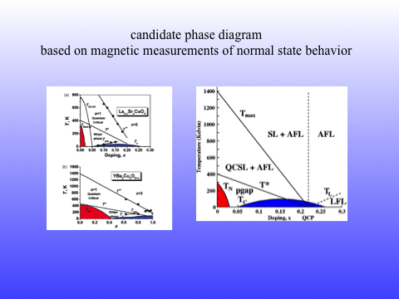

Slide 33
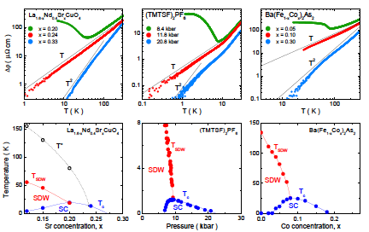

Slide 34
The Emergence of Heavy Electrons in Kondo Lattice Materials
In Kondo lattice materials, a lattice of local moments hybridizes with background conduction electrons to produce heavy electrons that display non-Landau Fermi liquid behavior and become superconducting.
Phenomenology, in the form of a two-fluid description of emergent heavy electron behavior, has now set the stage for solving one of the current major challenges in all of theoretical physics, the development of a microscopic theory of Kondo lattice materials.

Slide 35
Thanks to a phenomenological two-fluid theory of heavy electron emergence [Fisk, Nakatsuji, Pines, Curro, Schmalian,Yang, Thompson, Lonzarich,...] , here is what we now know.
*On the Kondo lattice, there are significant differences in how a lattice of local moments and a single-ion local moment hybridize with conduction electrons.
* Collective hybridization is generally much more effective than the single-ion local hybridization produced by the Kondo coupling J: it begins at a crossover temperature,
T* ~ J_{H} ~ ρJ² >>T_{K} ~ ρ ⁻¹ exp(−1/ ρJ);
J_{H}, the nearest neighbor coupling between local spins is found to be large compared to the single ion Kondo temperature T_{K}, in essentially all Kondo lattice materials

Slide 36
* Optical measurements of the direct hybridization gap, Δ, show that it reflects the collective origin of hybridization; these show that Δ ~ (T*/ρ)^{1/2} instead of the single ion hybridization value, Δ ~ (T_{K} /ρ)^{1/2} predicted by slave boson mean field theory.
* The quantum critical point of heavy electron materials is NOT set by the competition between the Kondo (single-ion) and RKKY energy scales given in the Doniach phase diagram; it is found in the vicinity of ρJ_{c} ~ 0.17, significantly below the Doniach value of ρJ_{c} ~ 0.35.
*The two-fluid description makes it possible to use hybridization effectiveness as a quantum tuning parameter and disentangle the average behavior of the itinerant heavy fermion liquid and local moment spin liquid below T*.

Slide 37
*The two-fluid model contains a hybridization effectiveness parameter, f₀, that is defined to be unity at the quantum critical point [QCP], while experiment yields a simple expression for the relative strength, f(T), of the emergent itinerant heavy fermion liquid,
f(T) = f₀ (1 – T/T*)^{3/2}.
* When f₀ =1, hybridization ends at T=0, the QCP
*When f₀ > 1, hybridization ends at finite temperatures along a delocalization line, T_{L}, given by f(T_{L}) = 1 or T_{L} =T *[ 1− f₀^{−2/3}]
* The itinerant heavy electron liquid that emerges below T* is a new state of matter, the Kondo liquid, a non-Landau Fermi liquid that can be seen directly in measurements of the Knight shift anomaly that yield its emergence and subsequent temperature variation.

Slide 38
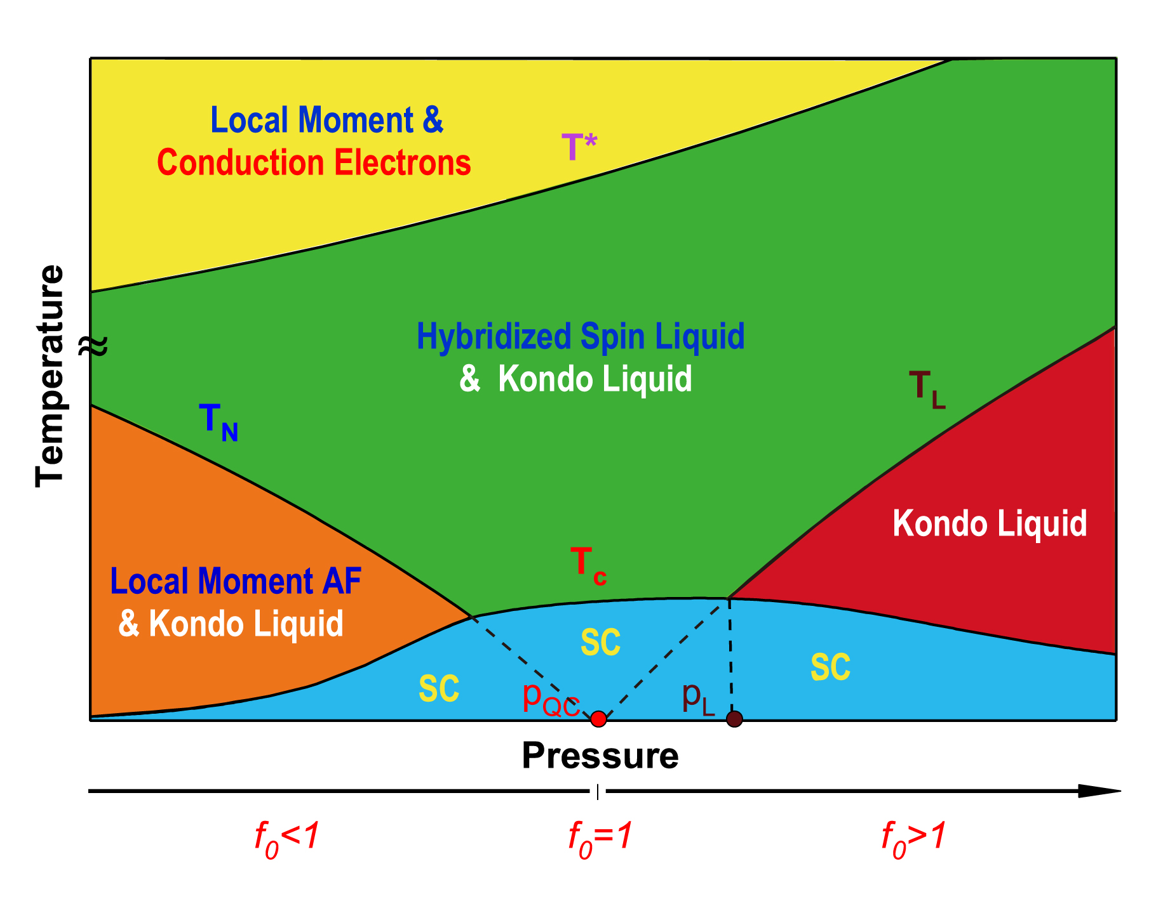

Slide 39
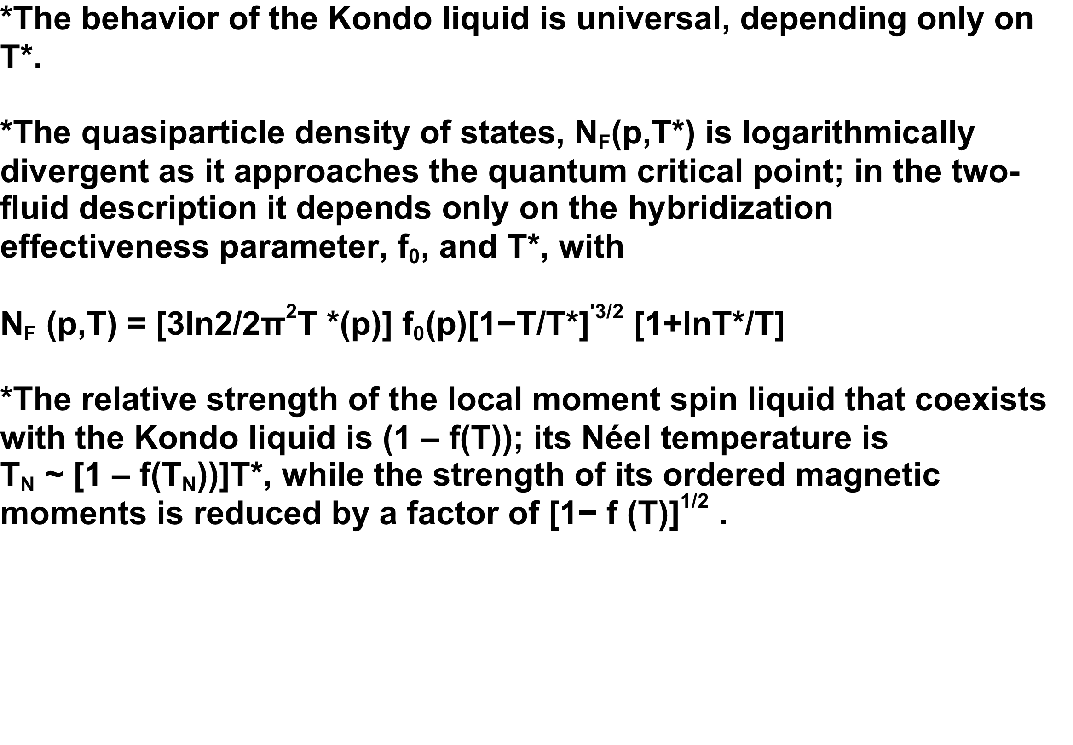

Slide 40
* The quantum critical tuning parameter, f₀, determines the circumstances under which superconductivity emerges at T_{c} from the Kondo liquid as a result of a spin-fluctuation induced interaction between quasiparticles
*The phenomenological BCS-like theory of Yang and Pines, in which
explains in remarkable detail the pressure variation of T_{c} seen in CeRhIn₅ and CeCoIn₅ when one uses experiment to determine the dimensionless coupling strength,
κ(p)=N_{F}(p,T_{c})k_{B}T*(p).

Slide 41
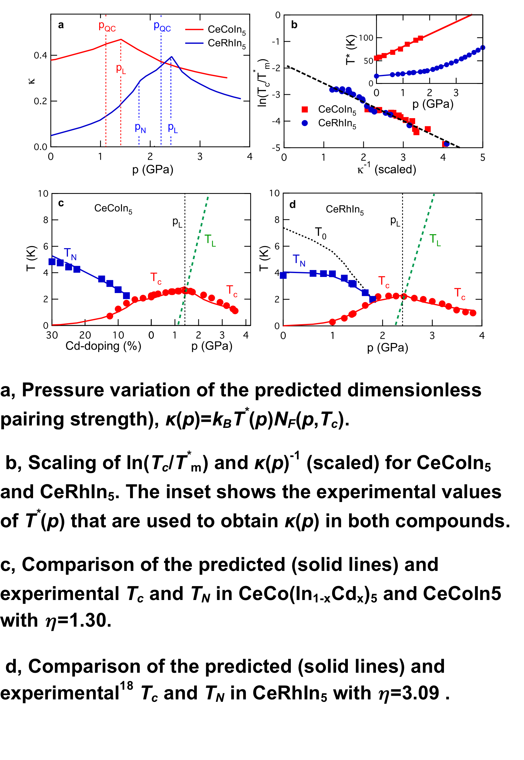

Slide 42
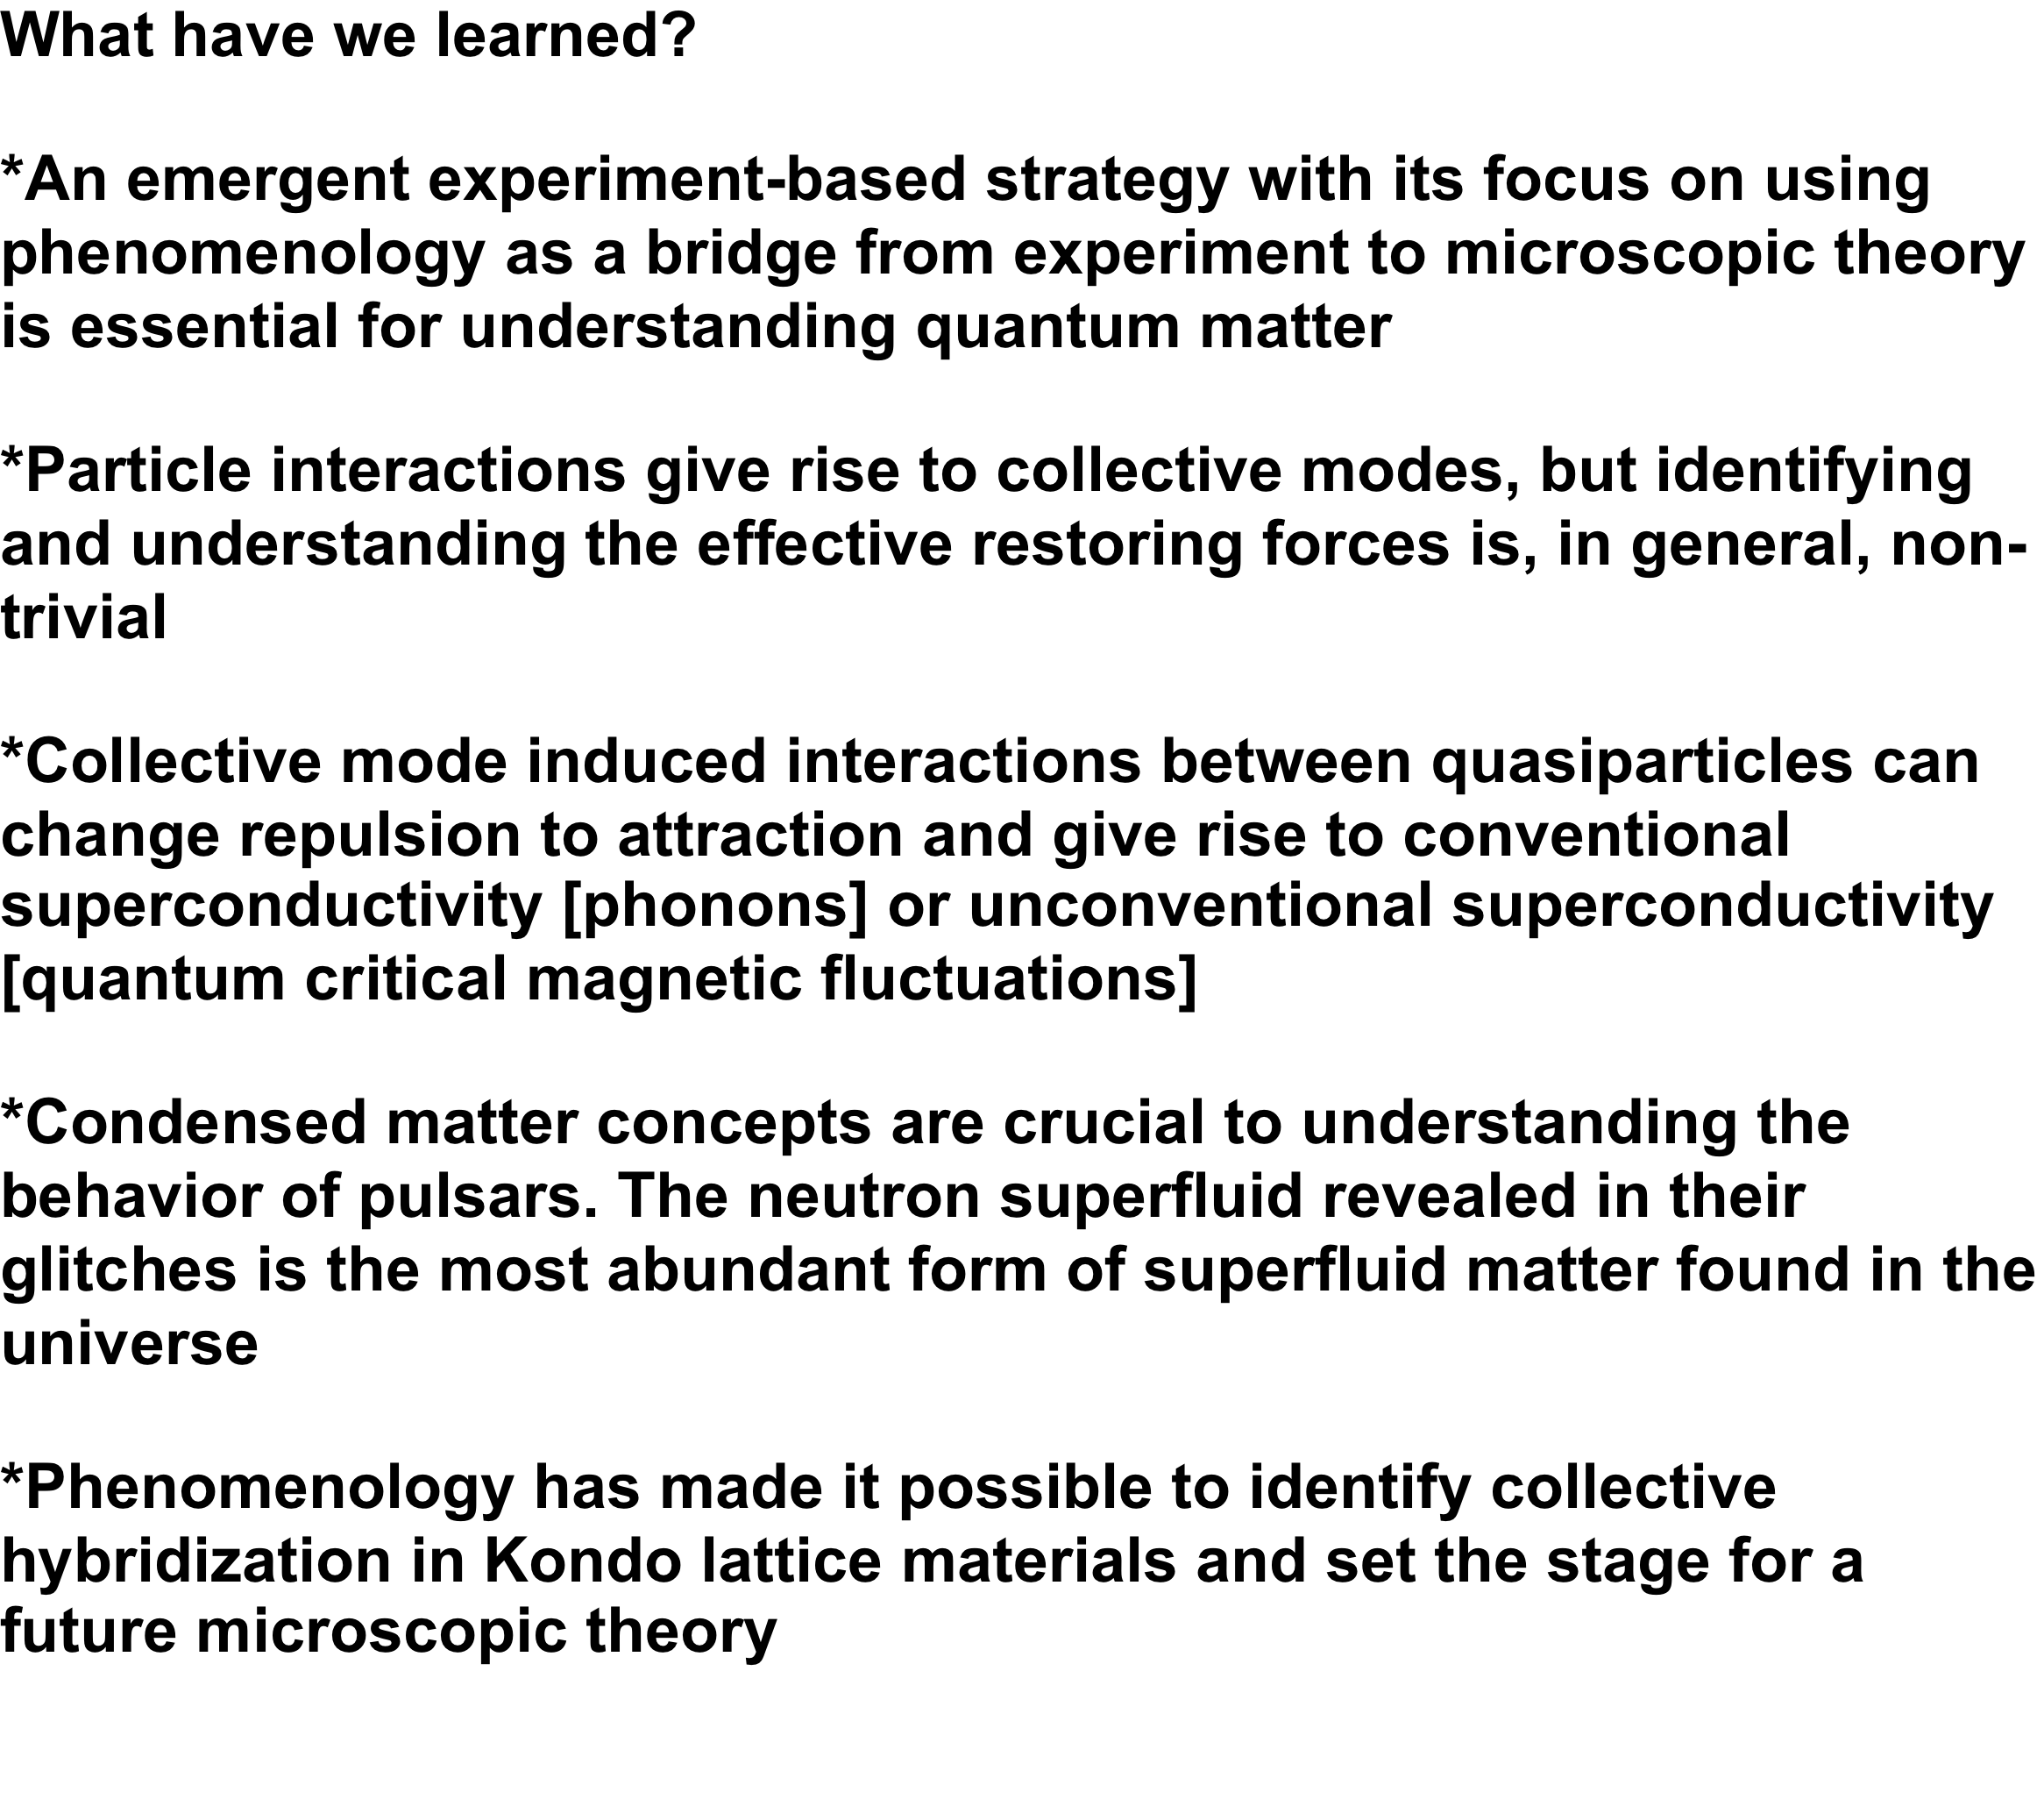

Slide 43
